Slide 1
Welcome to Work Based Learning
Teacher:
Dr. Patterson
Cell: 678 778 3724 Email: pattersonb@fultonschools.org
Drpattersonrocks@gmail.com

Slide 2

www.NorthSpringsWBL.org

Slide 3
Agenda
Schedule Fixes
AES
Paperwork
Responsibilities
Teacher Draft
Training Plan
Assignments
Attendance
Placement
Badges
Last Ditch Effort

Slide 4
Remind
Group Code:
@pattymelt
Text 81010

Slide 5
Appointments
Group Code:
calendly.com/pattersonb

Slide 6
https://learn.aeseducation.com
If you have WBL for two periods, sign up for the first period. YOUR LAST NAME IN AES should have your PERIOD NUMBER ATTACHED TO YOUR LAST NAME (ex. PATTERSON67)
A8D9R

Slide 7
On-Campus Opportunities
CBI
Teacher Aides
Bookkeeper
AVID
College and Career

Slide 8
Responsibilities
Off Campus Internship
Don’t Get Fired
Don’t Ruin Placement

Slide 9
Responsibilities
Teacher Aide
Create and maintain teacher websites | Turn standard PowerPoints into interactive Nearpods | Convert paper based test into digital, automatically graded tests
Turn previous quizzes into interactive study guides (Kahoot, Quizizz, GoFormative, etc.) | Find online video content via Youtube, Schooltube, or Teachertube that correlates with your standards | Help teachers go paperless by creating and maintaining Edmodo accounts
Teach mini lessons | Create electronic filing system | Provide enrichment activities
Help struggling students | Design alternative assessments | Create a digital calendar
Organize Web2.0 tools into a Symbaloo | Podcast your lessons via Screencast | Pre-grade assignments

Slide 10
What can on-campus interns NOT do??
You may NOT have your cell phone out AT ALL!! Please abide!
You may not eat while you are working!!
NO making copies of any type —NOT in the copy room and NOT in the Front Office
NO grading tests—’pre-grading’ can be ok.
NO access to eSchool on the supervisor’s computer – NEVER!!
NO errands for teachers without a signed HALL PASS.
  Mentorship tag is NOT a hall pass

Slide 11
Attendance
Attendance is CRUCIAL to being in Mentorship!!
You must show up ON TIME or e-mail your supervisor PRIOR to an absence or check-out — or call/text, if better for the supervisor—check with your supervisor!
Email ME!! MANDATORY!!!!
Treat this like a real job!
Absolutely NO no-shows!!

Slide 12

Dress
Dress must be very appropriate—kick it up a notch or two!!
You are representing NSHS and the WBL program and must be a role model!

Slide 13
Cutting Class
Never Cut! It is a PRIVILEGE to be in WBL Intern and you are a ROLE MODEL!
If I find that you cut WBL—you will be written up and possibly removed…
Parking privileges could be removed.

Slide 14
Paperwork
Part 2 Employer Portion
Training Plan
Syllabus Acknowledgement Form
  Get the BACK PAGE signed tonight!
Magnet Contract**

Slide 15
What Makes Up Your Grade:
Major 40%
  Employer Evaluations
Minor 30%
  Journal Entries
  Hours and Wages
Practice 10%
  AES
Final Exam 20%
  Electronic Career Portfolio

Slide 16
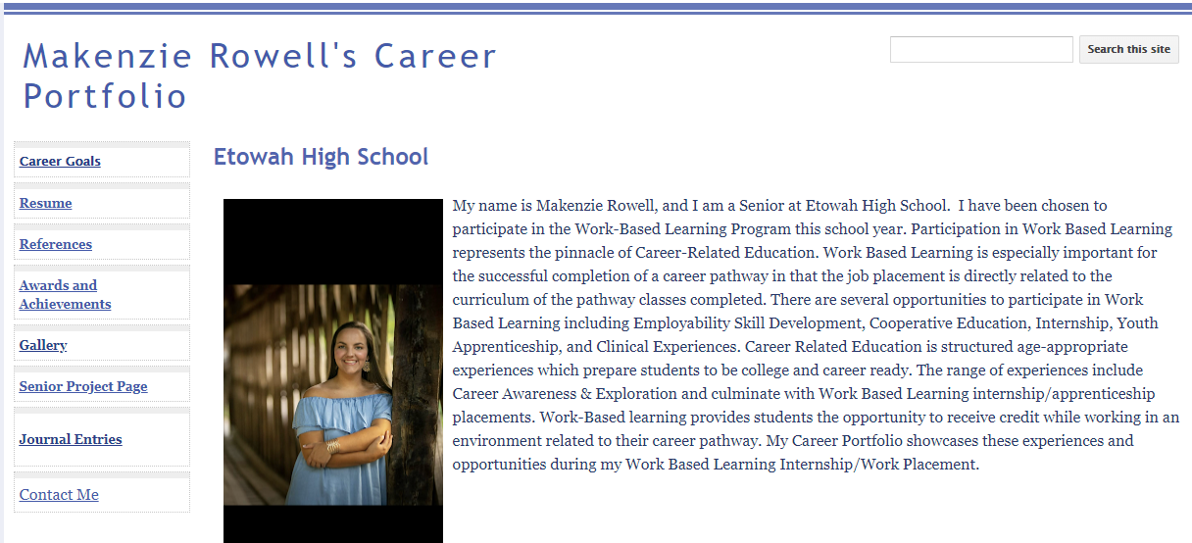

Slide 17
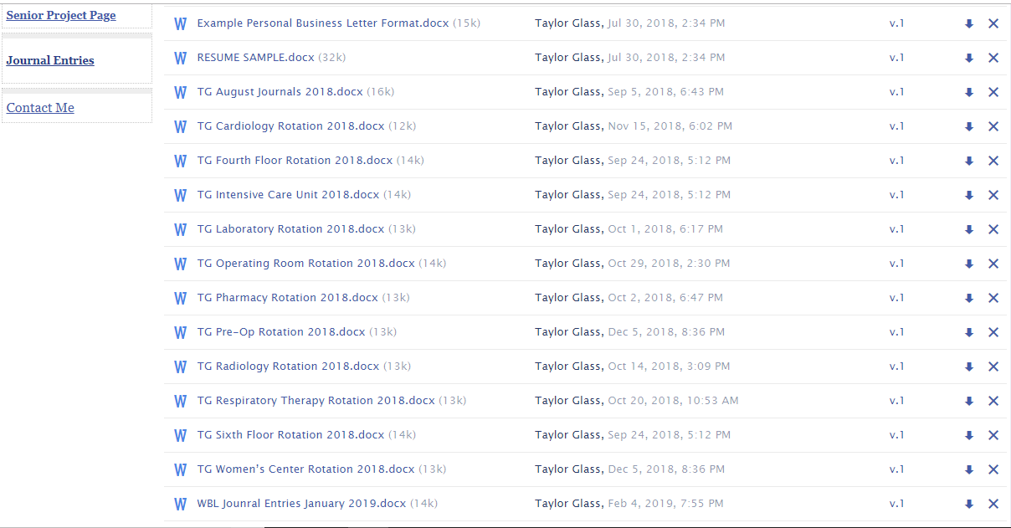

Slide 18
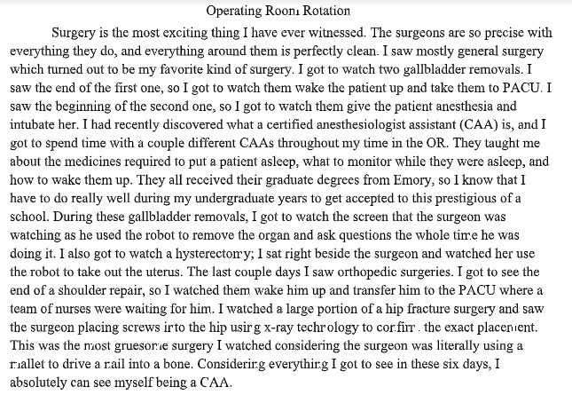

Slide 19
Contingency Plan
If your supervisor can NOT have you in the room for a day…report to ME.
I should be notified in advance!
If I will be out of my office – I will find an alternate place for you.
If your school or placement site is closed—report to ME—this is NOT a day off! ☺

Slide 20

OFF CAMPUS: NO JOB
Deadline September 1st
Last Ditch Effort
  Shoe
  Lottery Ticket
  Shiny Bubble Envelope

Slide 21
OFF CAMPUS: NO JOB
Balter Insurance
Elaine Bryan Foundation
Hammond Glen
CAC
Schiff School
Somerby Retirement Home
Ross and Pines, LLC
Cinnaholic
Consult Atlanta
JCC

Slide 22
On Campus
Ms. Kent
CBI
Ali
Shiflett
Lundy

Slide 23
